Slide 1
Decision Trees
Muhammad Umar
Notes:
ID=d924773e-9a16-4d6d-9803-8cb819e99682
Recipe=text_billboard
Type=TextOnly
Variant=0
FamilyID=AccentBoxWalbaum_Zero

Slide 2

Agenda
Training and Visualizing a Decision Trees
Making Predictions
Estimating Class Probabilities
The CART Training Algorithm
Computational Complexity
Regularization Hyperparameters
Regression
Instability

Slide 3




Introduction
A decision tree is a supervised machine learning algorithm that uses a tree like structure to predict a target.
It includes root nodes, decision nodes branches and leaf nodes.
Decision tree classify instances by splitting at the root of the tree and moving through it until a leaf node.
Greedy Search Algorithm

Slide 4
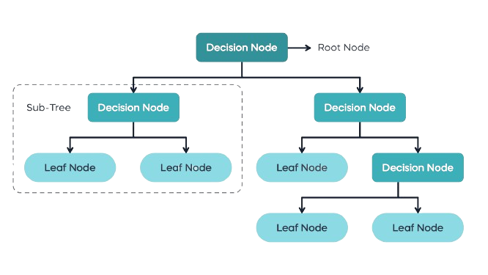
Common Terms
Root Node: The initial node at the beginning of a decision tree
Decision Node: A node shows a decision to be made.
Lead Node: Node where further splitting is not possible, end node
Sub Tree: A sub section of the entire tree
Figure: Common Decision Tree

Slide 5
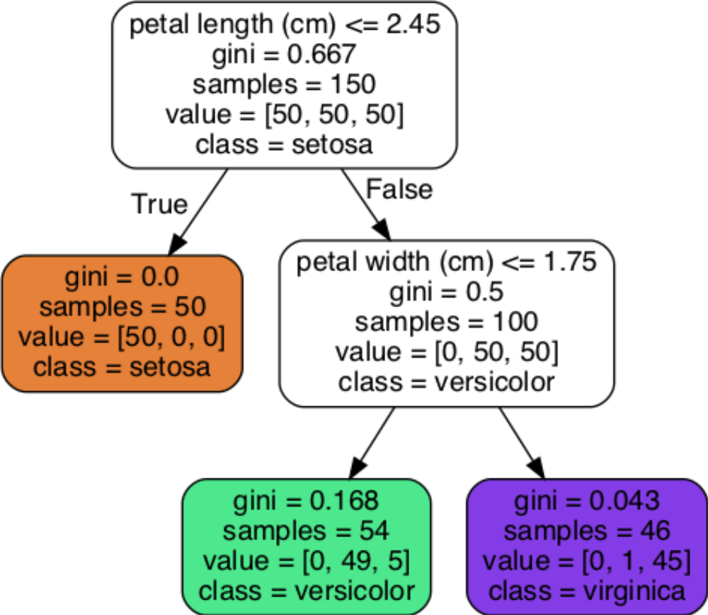
Working Principle
At each node, the algorithm chooses the best feature to split the data into subsets.
The split is based on the feature value that best separates the data points belonging to different classes (for classification) or values (for regression).
Figure: Iris Dataset DT

Slide 6
CART Training Algorithm
DT are used for Classification and Regression that is why it is called as Classification and Regression Trees (CART) Algorithm.

Slide 7
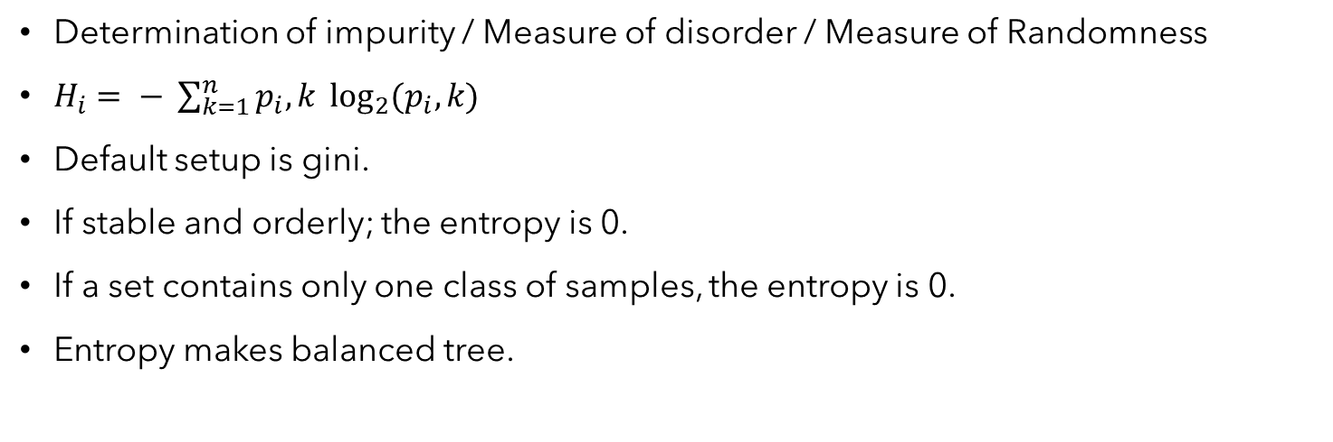
Gini or Entropy
Determination of impurity / Measure of disorder / Measure of Randomness
$H_{i}= − \sum_{k=1}^{n}{p_{i}, k \log_{2}{{(p}_{i}, k)}}$
Default setup is gini.
If stable and orderly; the entropy is 0.
If a set contains only one class of samples, the entropy is 0.
Entropy makes balanced tree.

Slide 8
Advantages and Disadvantages
Advantages
Flexible
No feature scaling
Interpretability
Fast
Disadvantages
Overfitting
Sensitivity to Data Changes
Decision Trees
8

Slide 9
Thank you

